Slide 1
CONSERVATION BIOLOGY
Unit 8. POSSIBLE GENERAL SOLUTIONS TO CONSERVATION PROBLEMS
8.1. Design and management of protected areas.
8.2. Ecological Corridors.
8.3. Attenuation of the impact of urbanization and infrastructure.
8.4. Environmental impact assessment.
8.5. Control of alien invasive species.
8.6. Ex situ conservation.
8.7. Captive breeding: basic notions.
8.8. Reintroductions and reinforces.
8.9. Restoration ecology.

Slide 2
8.5. Control of alien invasive species
Alien species and Biogeography
Although most species are continually shifting their ranges, particularly in response to climate change, these movements are often impeded by barriers. This barriers may be as subtle as a minor change in temperature or salinity or as stronger as an ocean or mountain range.
Many barriers are very effective and new genes and new species arise. In this way, each place stands each own species.
In the last centuries, isolation has been diminished for many species due to worldwide movement of people, especially with the maritime shipping.
A new agent for moving biota around the world was created and range shifts for many species have been accelerated by human activities.
Species from and to remote sites have been shuffled as a deck of cards all around the World.
This effect is especially evident in islands and in aquatic ecosystems.

Slide 3
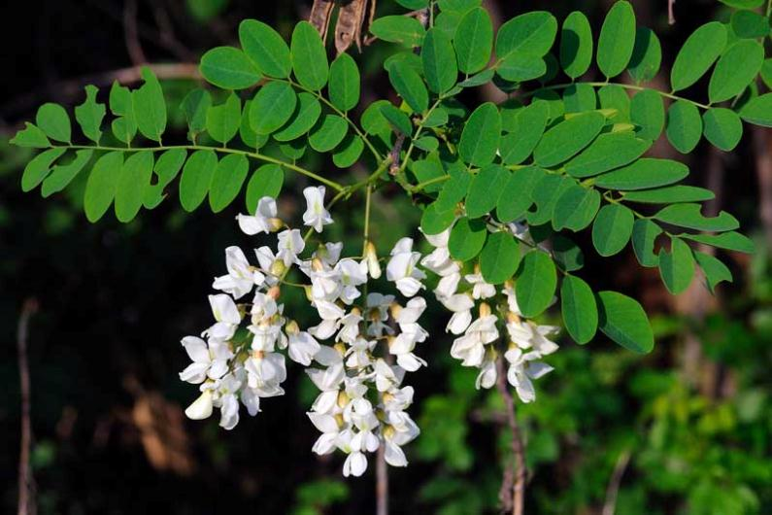
8.5. Control of alien invasive species
Invasion by alien species represents one of the greatest biological threats to biodiversity, second only to habitat destruction.
Example: The false acacia (Robinia pseudoacacia) was introduced from North America into a private French garden during the 18th century. It remained within the perimeter of the garden until the early 1900s when the blight of chestnut woods fostered its diffusion throughout Europe. Now the removal of this plant is carried out within several LIFE Nature projects

Slide 4
8.5. Control of alien invasive species
When a species is introduced in a different area far from the original one and the new populations are able to establish and survive in the new environment, this species are considered as:
✔ Naturalized. The climates are similar in local and original sites and the species is definitely established in the new territory. The introduced population of species established in the wild with free-living, self-maintaining and self-perpetuating populations unsupported by and independent of humans
✔ Adventive. Pronounced climatic (environmental) differences between local and original site. The species can be established but the survival is uncertain. A minor drastic change can eliminate the species.
✔ Acclimatized. Strong climatic differences. A species living in the wild in an alien environment or climate with the support (i.e. for food and shelter) of humans. Only the intervention of human guarantee the survival of the species. The main examples are cultivated plants and domestic animals: orange tree, rice, etc.
When the species is able to displace the original species at local site then it is considered as invasive species.

Slide 5
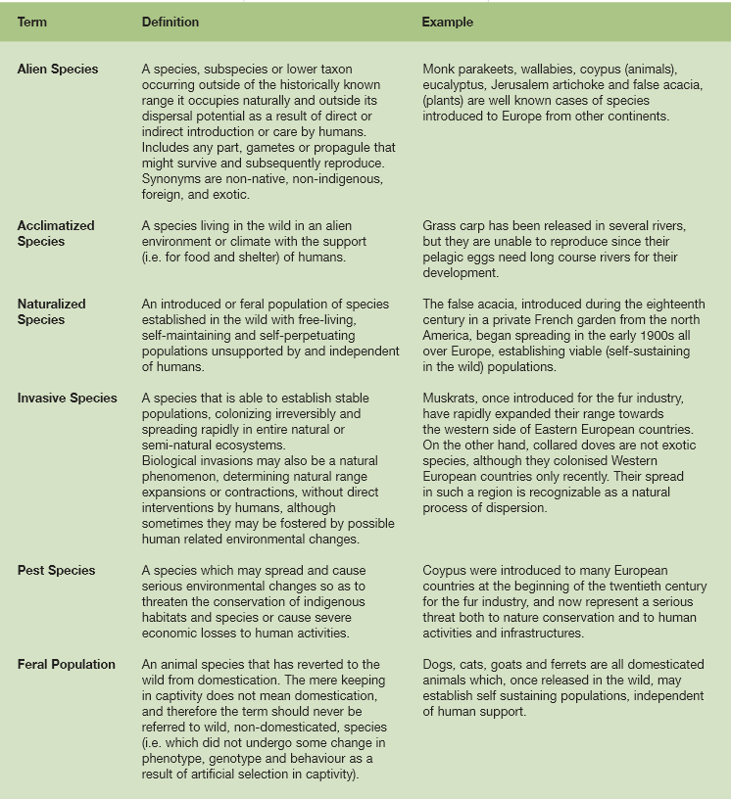
Review of concepts
http://ec.europa.eu/environment/life/publications/lifepublications/lifefocus/documents/alienspecies_en.pdf

Slide 6
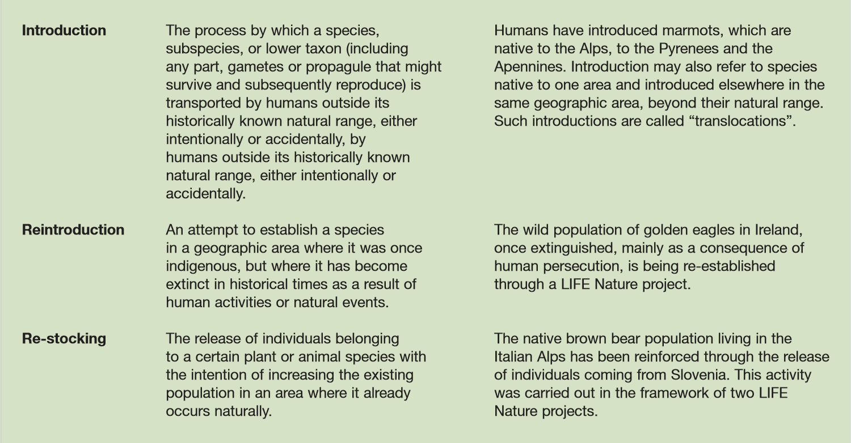
Review of concepts
http://ec.europa.eu/environment/life/publications/lifepublications/lifefocus/documents/alienspecies_en.pdf

Slide 7
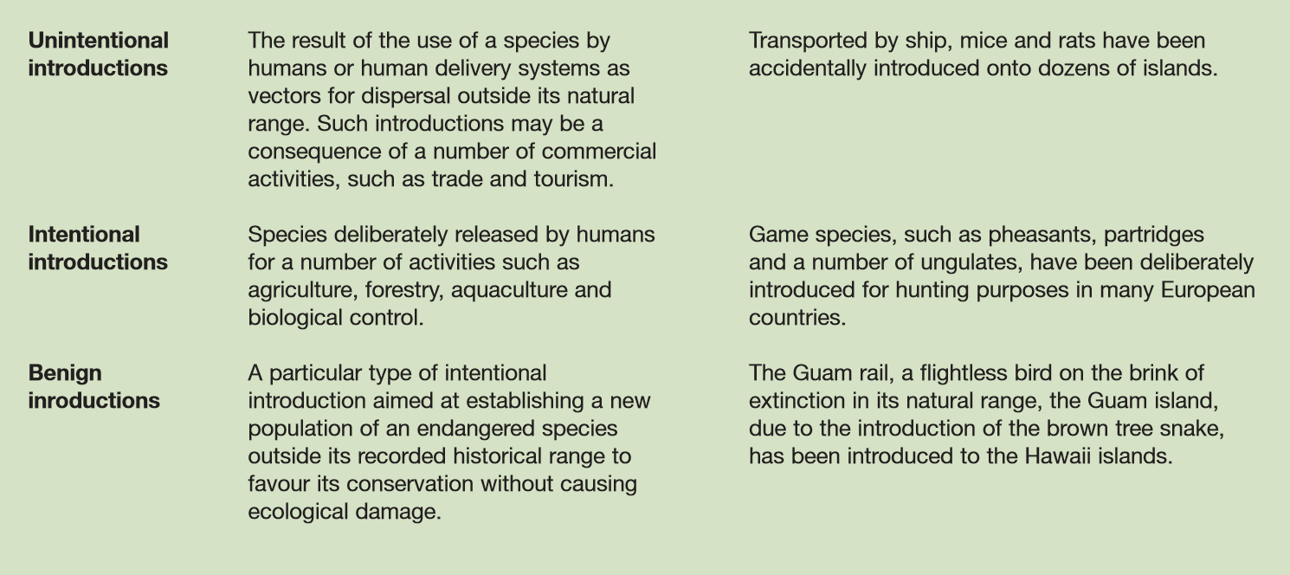
Review of concepts
http://ec.europa.eu/environment/life/publications/lifepublications/lifefocus/documents/alienspecies_en.pdf

Slide 8
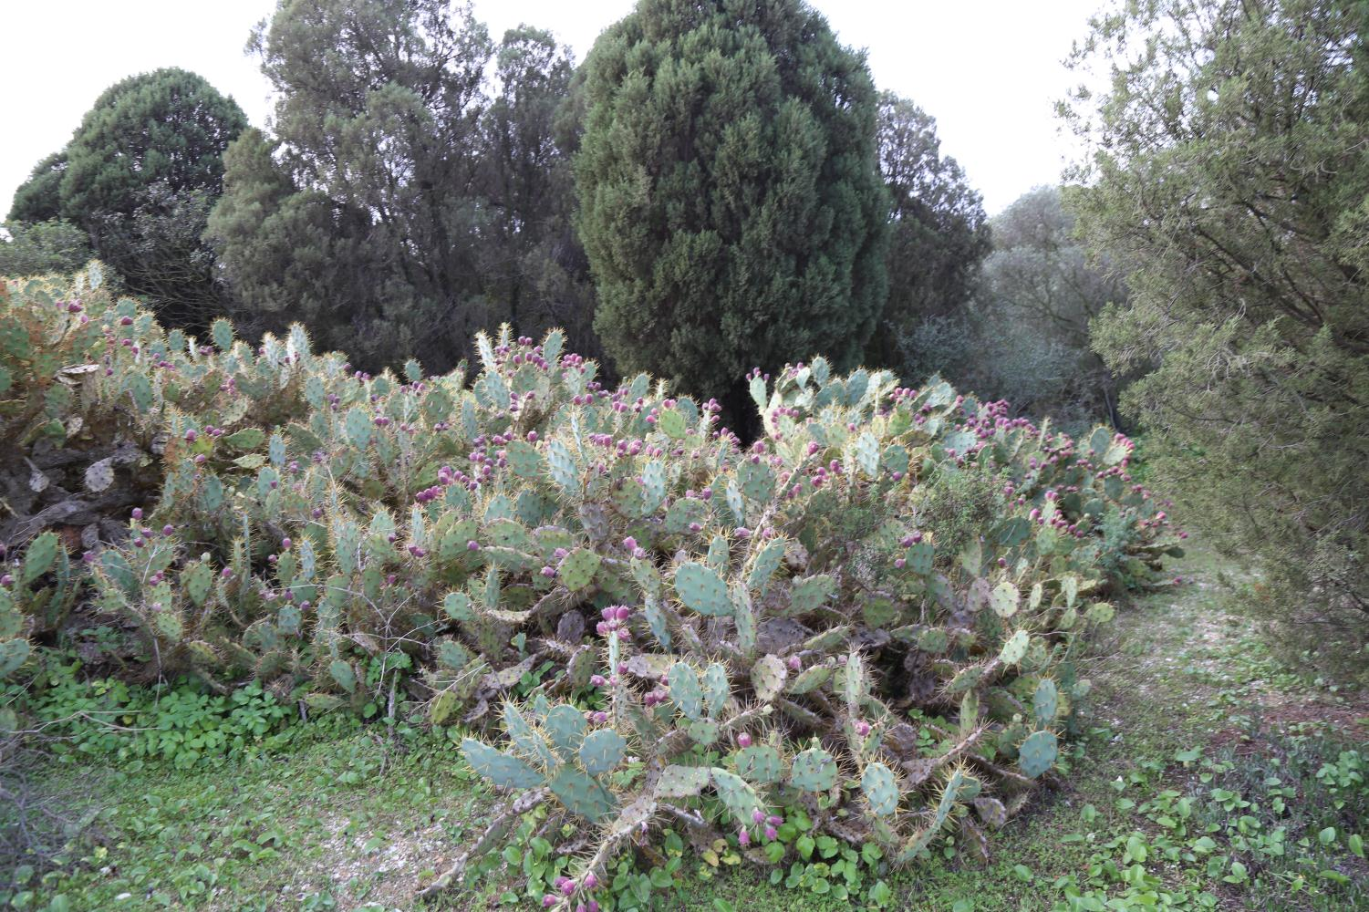
Opuntia dillenii (Cactaceae): naturalized or adventive? Frequent as hedges or fences.
Introduced in Europe in the 16th Century by American colonist. Originally from Central America.

Slide 9
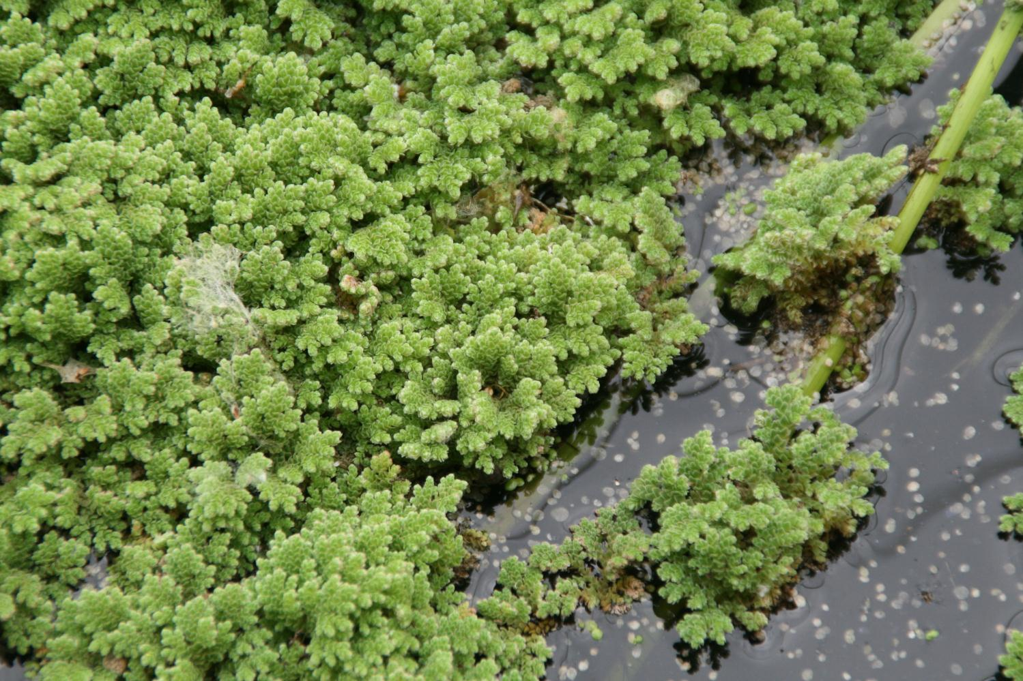
Azolla filiculoides (acuatic fern). Originally from Tropical America. Fast growing (dense floating layers) in favorable conditions.

Slide 10
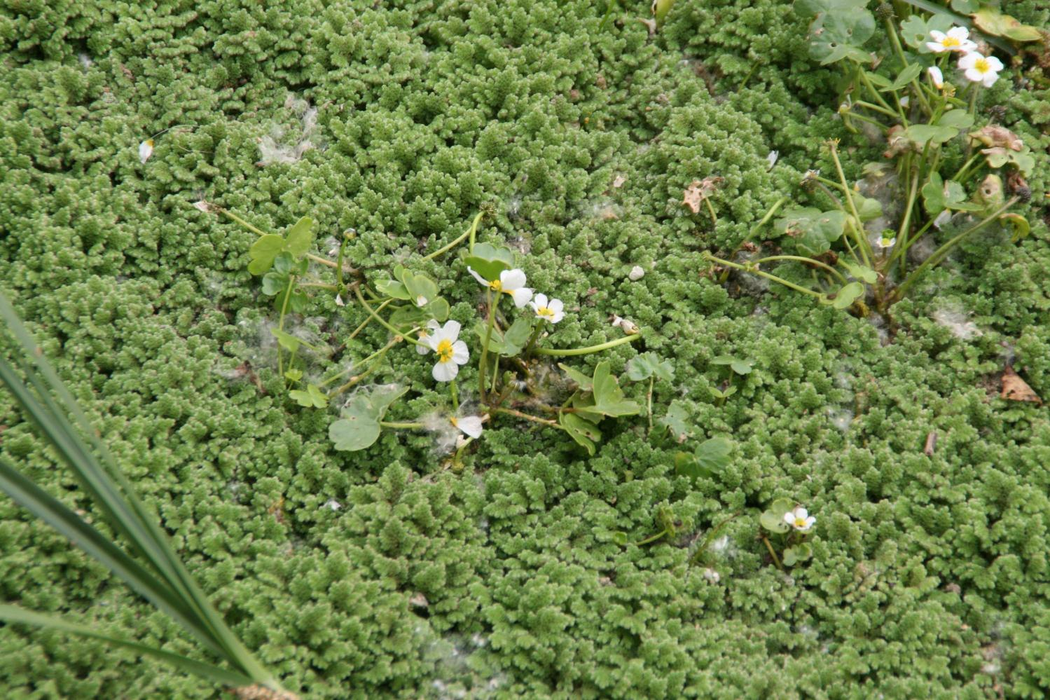
Displacement of native species: Alien invasive species!

Slide 11
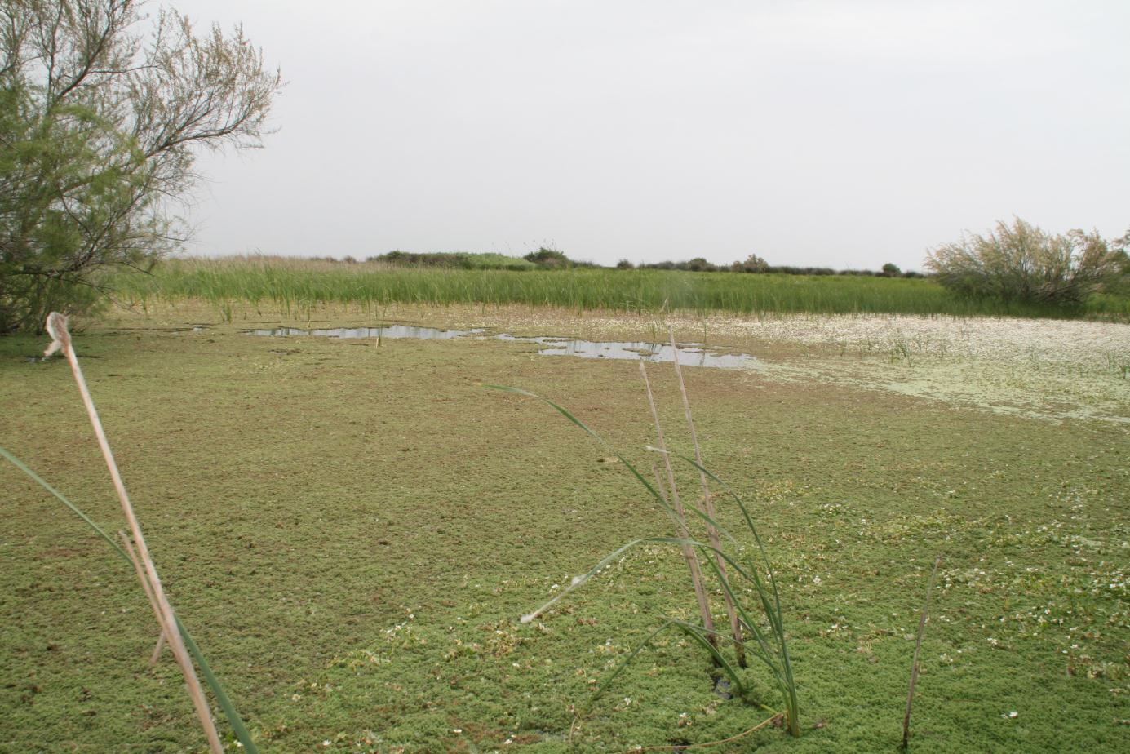

Slide 12
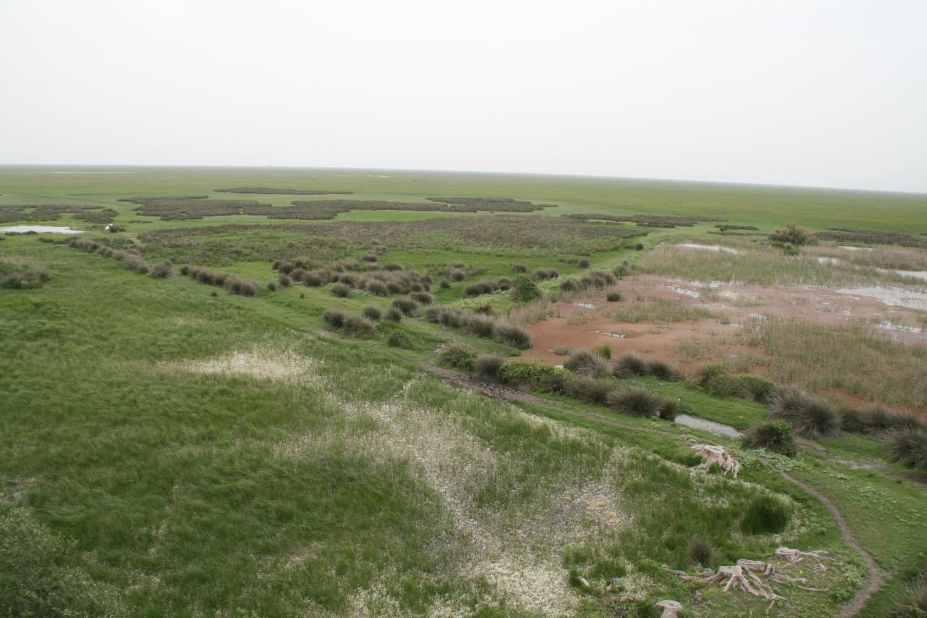
Difficult to control. Physical and chemical control. Wild killer (herbicides) are not allowed in protected sites: dilemma!

Slide 13
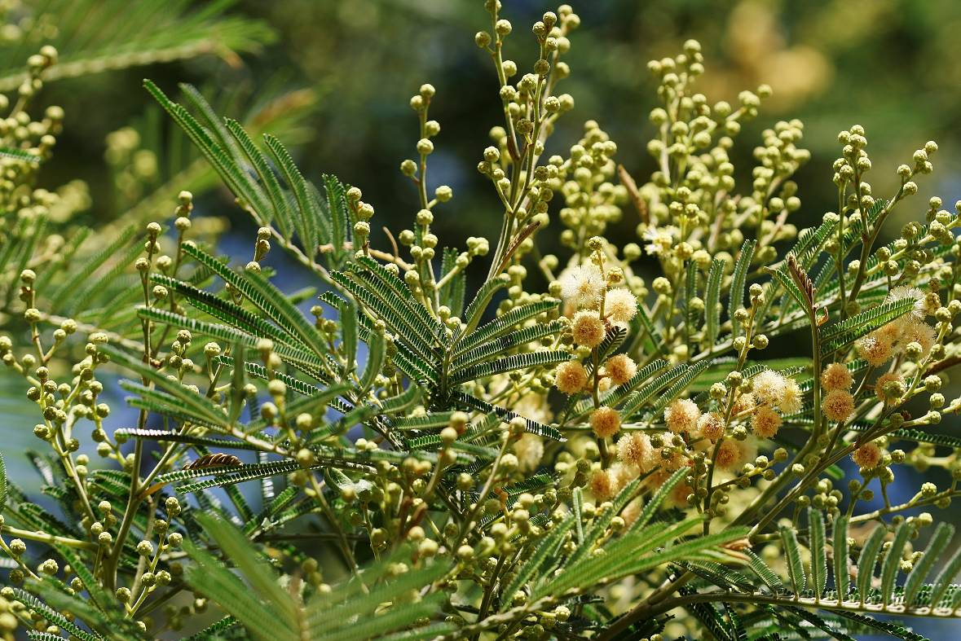
Acadia dealbata (Mimosaceae): Originally from Australia and Tasmania. Introduces in gardens. Fast growing, stimulated by fires, long live seeds.

Slide 14
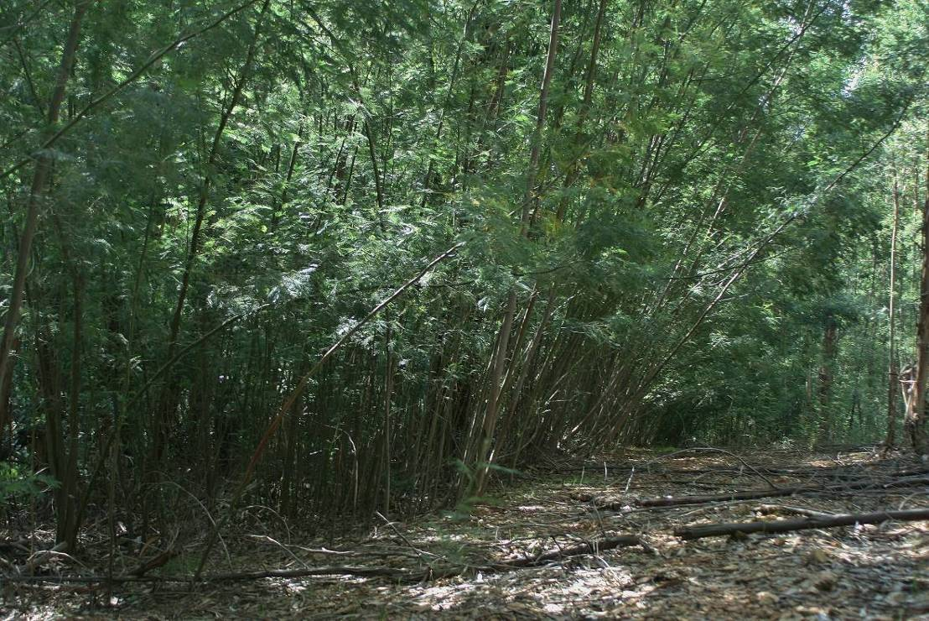
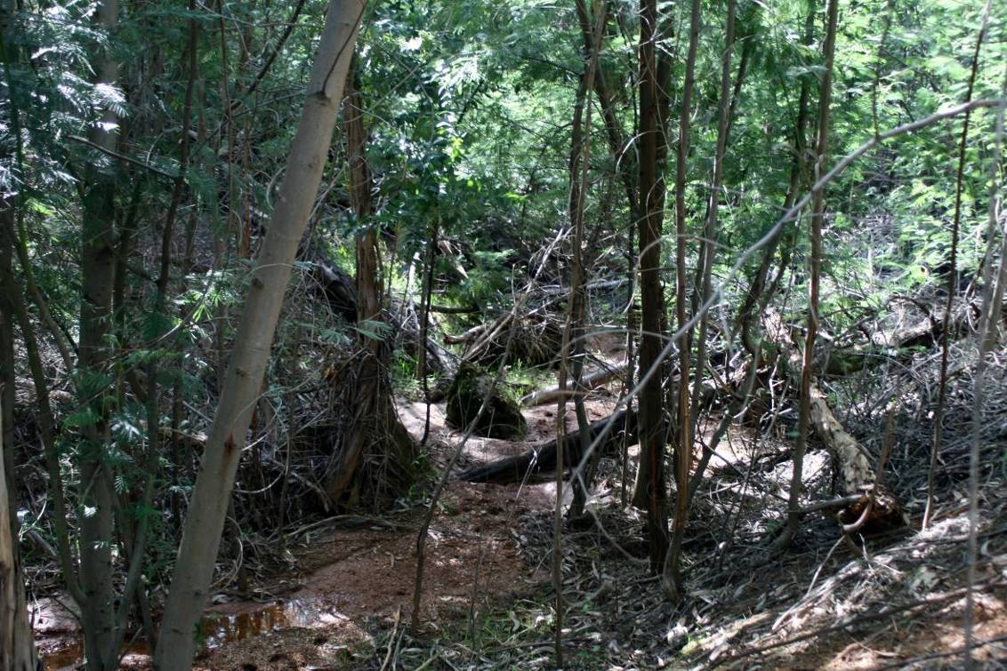
Acadia dealbata is widely spread in the province of Huelva displacing riparian forests. Arroyo de la Rocina and other well preserved rivers are seriously affected.

Slide 15
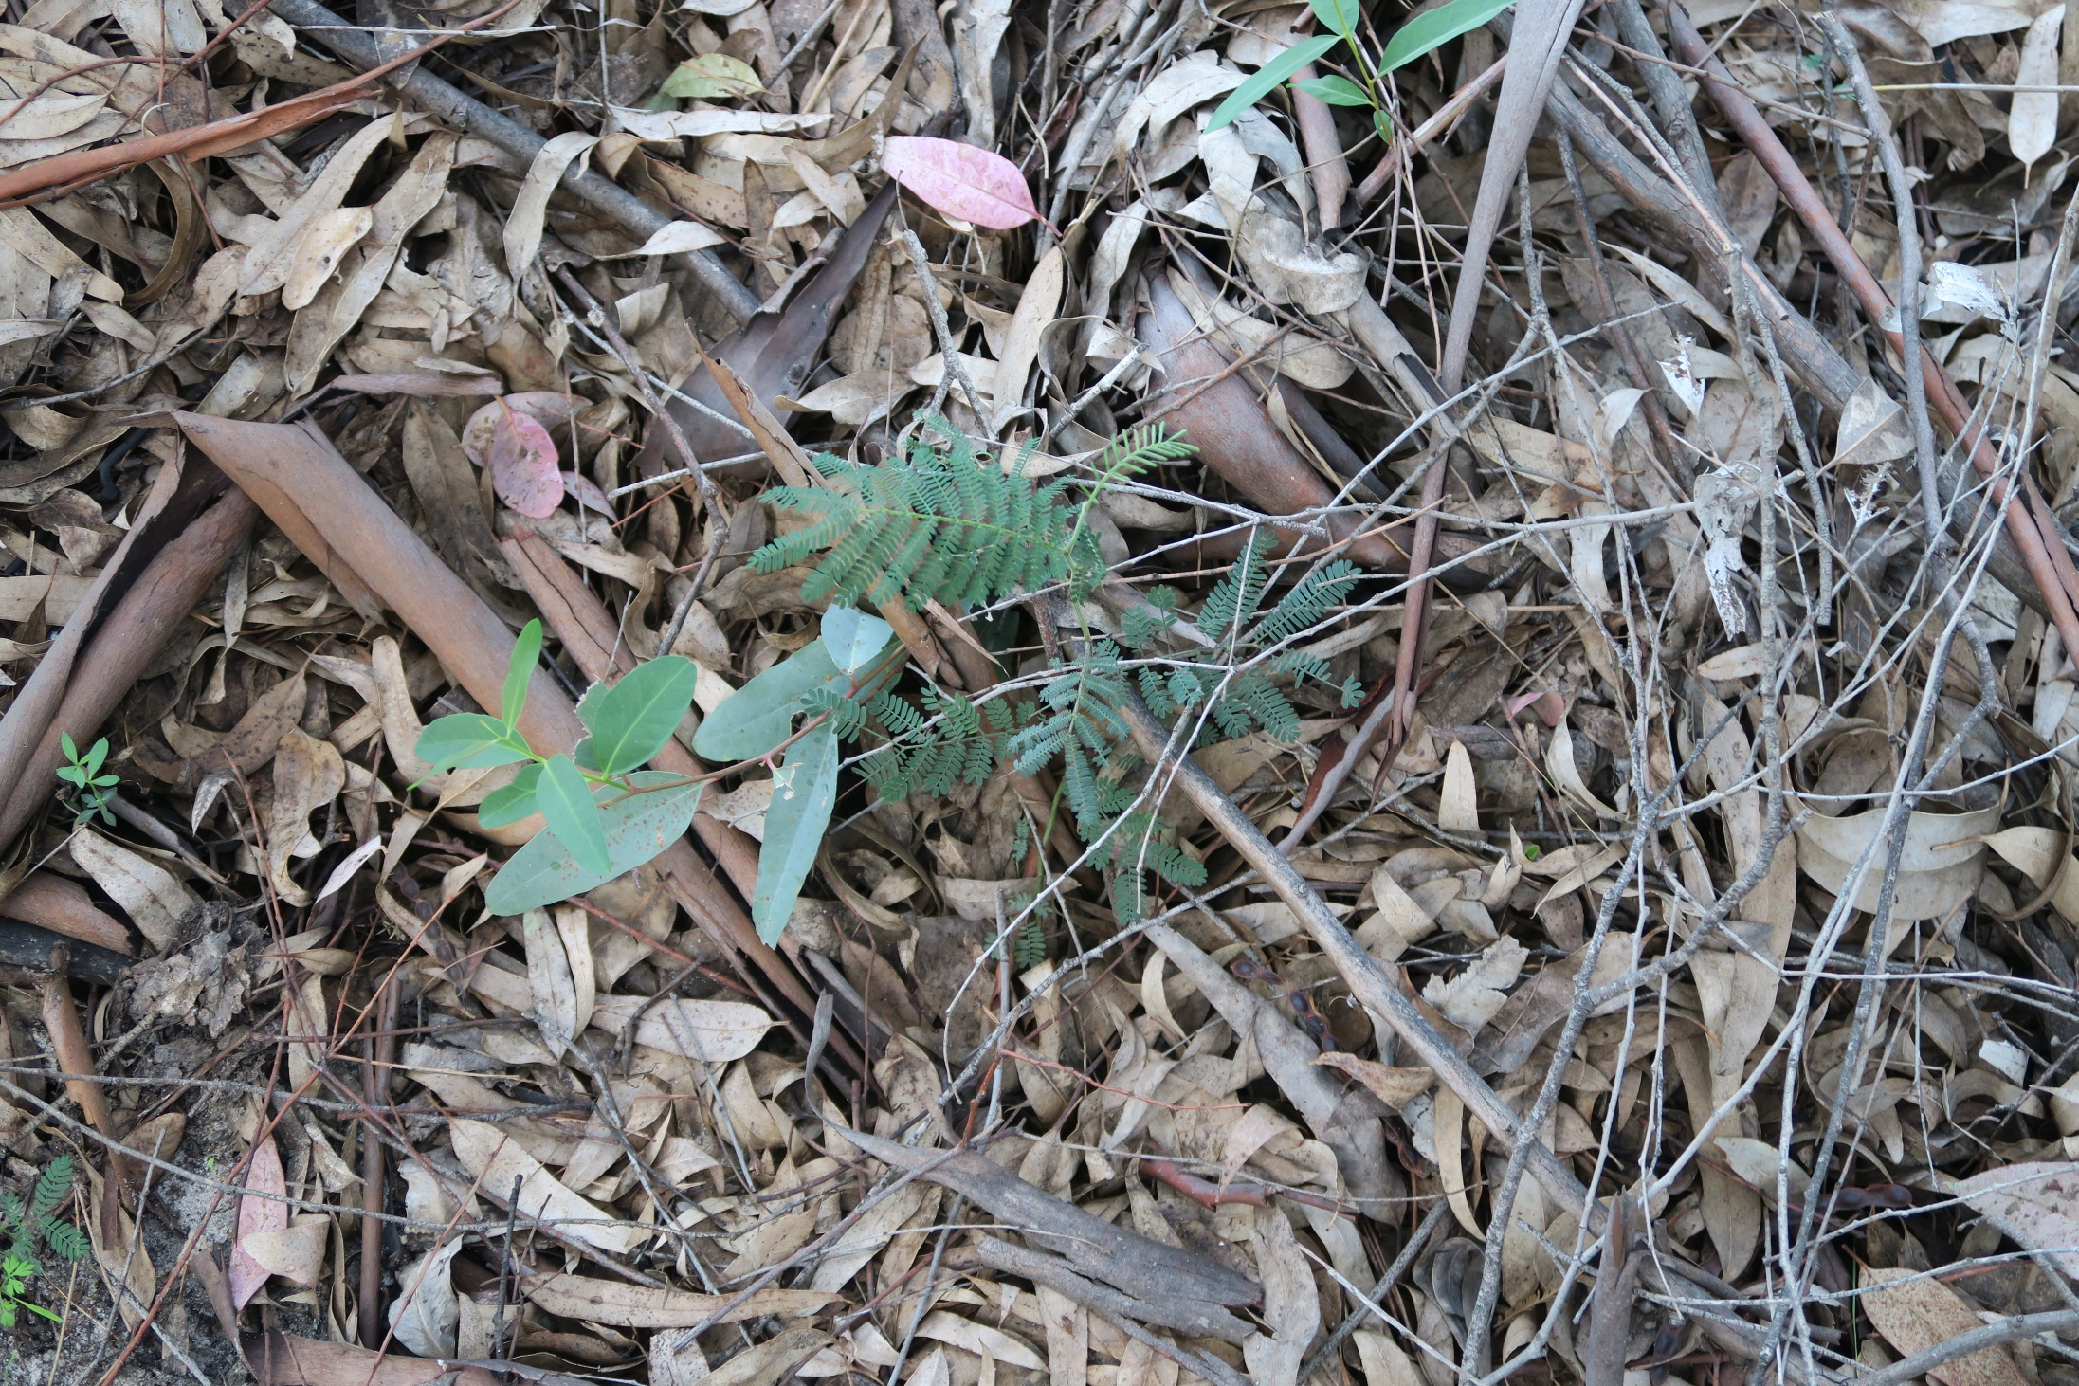
Acadia dealbata seedling.

Slide 16
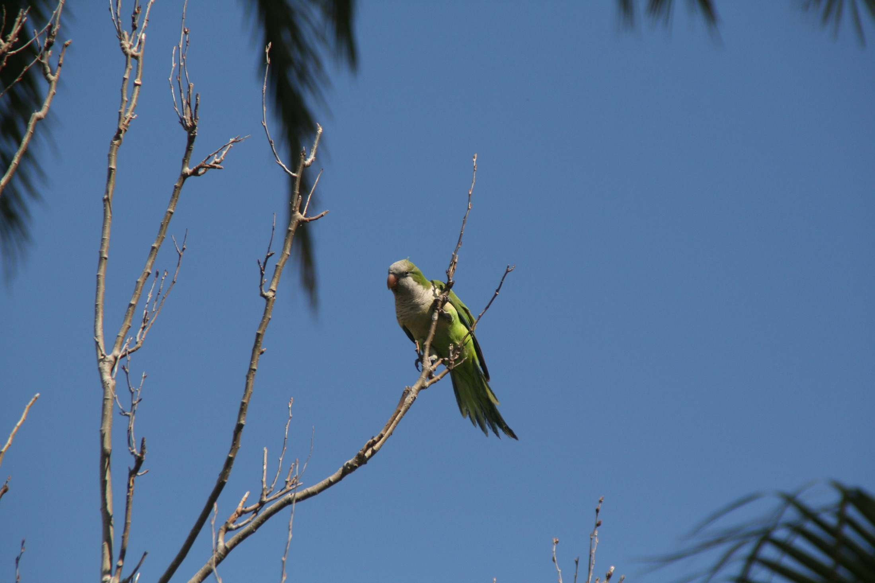
Parrots (Monk parakeet): Originally from America. Introduced as pets.

Slide 17
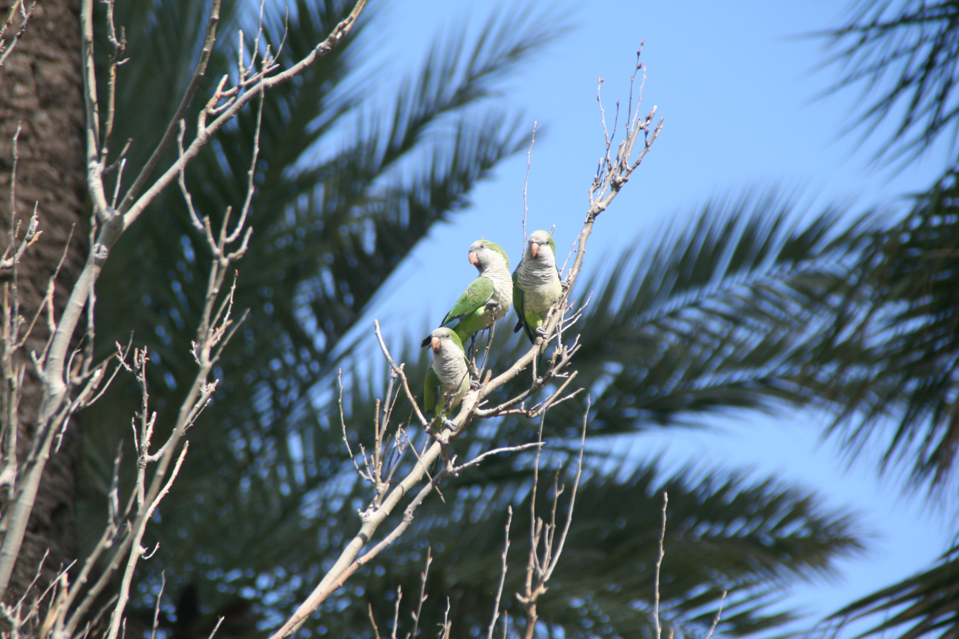
Parrots (Monk parakeet): Originally from America. Introduced as pets.

Slide 18
Vulnerability to invasions
✔ Impact on species/population. Predation directly on native species (plants or animals) changing prey-predator balance. Indigenous species do not have adequate defensive behaviour. American mink (Mustela vison), Feral dogs, etc. Introduced competitors that interact for the exploitation of the same resources (i.e. food, water, shelter, light, etc.), which reach a natural dynamic balance. Genetic when they can interbreed with closely related native species. This genetic exchange may result in a loss of the genetic integrity of the native species and in the formation of hybrids
✔ Impact on habitats/ecosystems: Effect on ecosystem characteristics including habitat structure (herbaceous, shrubs and arboreal layers), resilience to disturbance regimens (fires, meteorological events, erosion), and nutrient cycling (nitrification, etc.). Ex. Spartina densiflora in Marismas de Odiel. Acacia dealbata. Caulerpa taxifolia.
✔ Health impacts: New diseases are often spread by the introduction of alien species, which can act as vectors for pathogens or can cause disease themselves directly. This can threaten not only native species of plants and animals, but also humans. Example: Phylloxera vastratix.
Mustela vison http://www.magrama.gob.es/es/ceneam/grupos-de-trabajo-y-seminarios/red-parques-nacionales/Estrategia_de_Control_y_Erradicaci%C3%B3n_del_Vis%C3%B3n_Americano_tcm7-326549.pdf
Caulerpa taxifolia http://www.magrama.gob.es/es/biodiversidad/temas/conservacion-de-especies/caulerpa_taxifolia_2013_tcm7-306899.pdf
Phylloxera vastratix https://es.wikipedia.org/wiki/Dactylosphaera_vitifoliae

Slide 19
Vulnerability to invasions
How are species introduced?
✔ Unintentional or intentional pathways?
Stowaways: a large portion of species transported around the globe were stowaways. The house mouse and black rat (ship rat) are good examples and cause the loss of billions of dollars each year. Besides, they have also been responsible in the extinction of many species, particularly on islands. Sometimes they are overlooked (microorganisms, disease organisms, eggs and pupae on foods, logs, etc). Example: Zebra mussel. Vessels for oceanic crossing without charge take seawater for stability. At their destination they discharge the water with millions of small creatures. Mud in cars, boots, etc.… This way is considered as unintentional way.

Slide 20
Vulnerability to invasions
How are species introduced?
✔ Unintentional or intentional pathways?
Subsistence and commerce: Motivated by our need for food. Pigs, dogs, chickens, potatoes, bananas, etc. Colonists everywhere have brought with them and sent domestic plants and animals back to their homeland. Example: Agriculture, aquiculture, forestry, etc. Exotic tree species that escape to the control of the timber industry.
Recreation: sport hunters and anglers have been very active in the planned introduction of exotic wild species. Game birds. Example: American crayfish.
Ornamental plants and pets: Escape or abandoned to the environment. Example: tortoises, parrots, snakes, etc.
Scientific: Research, collections, breeding colonies in laboratories, etc.

Slide 21
Prevention
How do we manage species invasions?
✔ Invasion prevention. Prevention is the best way to manage species invasions. Barrier control, legislation, inspection. Convention Biological Diversity, Rio, article 8.h.
✔ Physical control. Trapping, hunting, digging, pulling. Effective in prolific species?
✔ Chemical control: pesticides, herbicides, medication. Allowed in protected sites?
✔ Biological control. The enhancement of native or introduction of nonnative predators, parasites, or diseases. Sometimes worse than useless! The predator, parasites or pathogens should be completely dependent on the host species you are trying to control.
✔ Sometimes impossible to eradicate: Naturalized?

